Slide 1
EFFICIENTLIVING.COM.AU
Sustainable Building Consultants
Creating a high-performance built environment for the future.

Slide 2
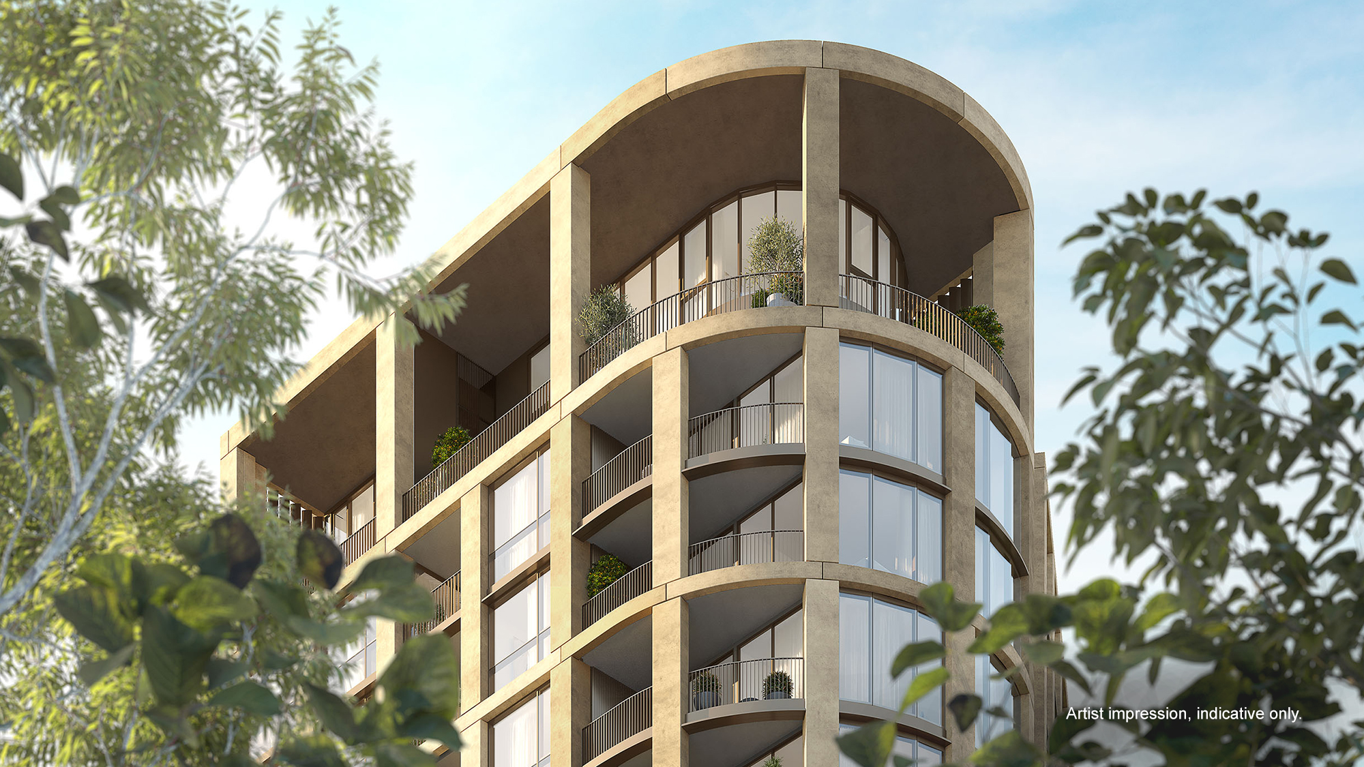
Who We Are
^{Image: Frasers Property} ^{Cover: Aqualand Projects}

Slide 3
Who We Are
PARTNERS FROM CONCEPT TO DELIVERY
Founded in 2000, Efficient Living is an Australian-owned sustainable building consultancy offering the design and construction industry a full suite of environmentally sustainable design (ESD) services.
We are a diverse team of architects, engineers, scientists, building designers and sustainability experts, and we’re exceptional at what we do. Each of us has sustainability at the fore, but we also have an intricate understanding of how construction works and how buildings come together.
Our focus is always to help our clients create buildings that perform their best. We pride ourselves on our ability to provide simple buildable solutions that provide tangible benefits to the environment and occupants within a range of budgets and sustainability appetites.
We work with our clients to create a built environment for the future, where practical design and efficient systems enhance occupants’ wellbeing, increase community resilience and reduce environmental impacts.
¹⁵²³
^{Clients}
^{9,078}
^{Projects}
^{26,279}
^{Dwellings}
²³
^{Years}

Slide 4
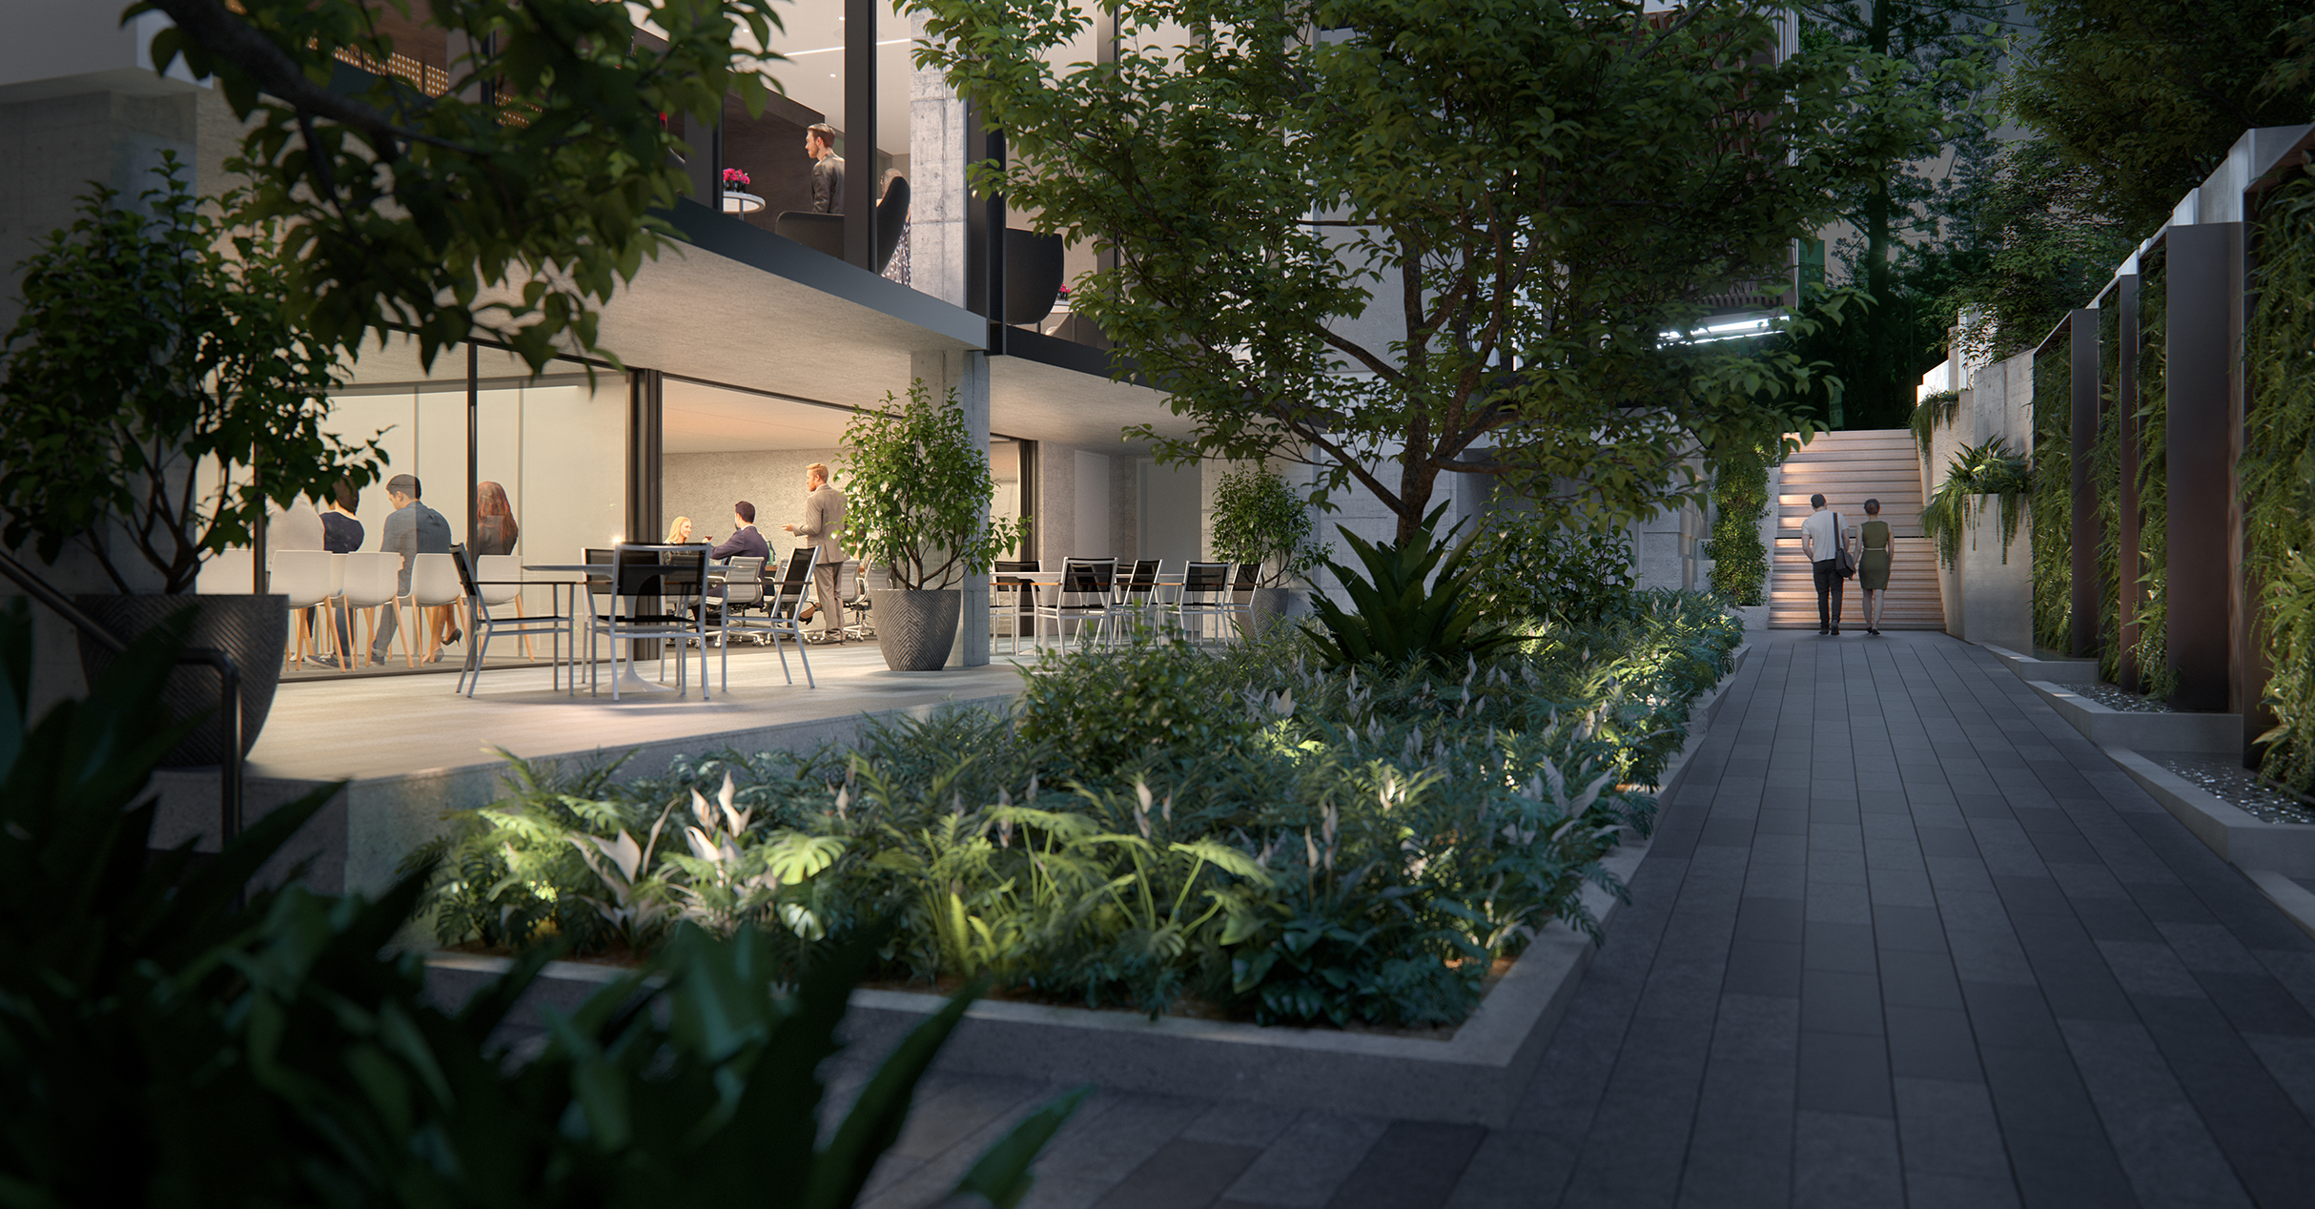
“Our built environment is the world’s largest contributor to greenhouse gases, it consumes about a third of our water and generates 40% of our waste.”
— Green Building Council of Australia

Slide 5
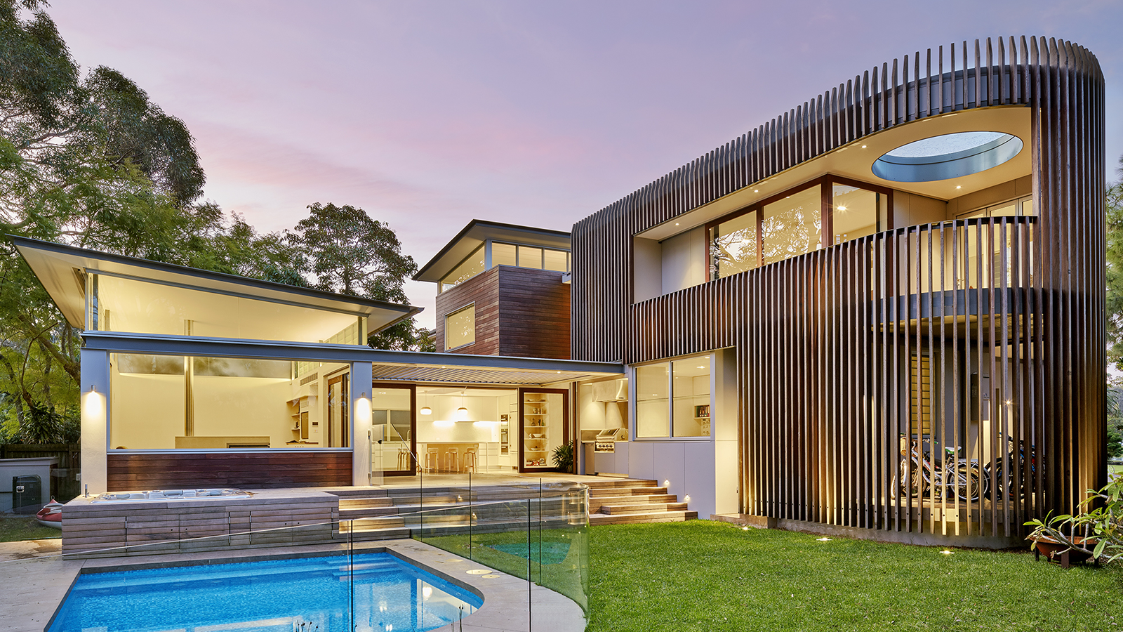
What We Do
^{Image: Utz Sanby Architects}

Slide 6
What We Do
Embedding sustainability in high-performance buildings is more than just modelling – though we are expert modellers! It’s about balancing construction practicalities with sustainability impact and financial budget to create lasting benefits.
PARTNERS FROM CONCEPT TO DELIVERY
We work alongside designers, builders, developers, architects and suppliers to optimise buildings at all stages of project delivery, whether it be workshopping sustainability into initial concepts and designs, modelling thermal comfort, inspecting buildings on-site or retrospectively remedying ongoing operational issues.
Our work spans all types of residential and commercial projects, from single dwellings, project homes, multi-residential apartments and boarding houses to hotels and shopping, childcare and town centres.
We always deliver best-in-market sustainability solutions, whether the goal is to gain simple regulatory compliance, world-leading sustainability certifications and everything in-between.
With the National Construction Code increase to 7-star homes in 2022 and net-zero buildings on the horizon, we are increasingly supporting our clients as they navigate the new requirements of construction in a low-carbon world.

Slide 7
^{Image: Frasers Property}
What We Do
RESIDENTIAL BUILDINGS
^{OUR SERVICES:}
Environmental and marketing strategy workshops at master planning stage
Testing and guidance at design stage
NatHERS thermal comfort modelling
^{BASIX (NSW) assessments}
Green Star rating certifications
NABERS ratings and commitment agreements
^{BESS (Vic.)}
Onsite inspections and builders’ compliance support
We help architects and developers create homes that not only look spectacular, but also feel comfortable to live in and perform their best within their local environment.
Our highest-volume and fastest-turnaround service is regulatory thermal comfort assessments and modelling for renovations and newbuilds, although we are increasingly partnering with clients to achieve Green Star and NABERS ratings.
Traditional building techniques and materials will evolve dramatically over the coming decade as policy guides the transition to net-zero homes.
We are currently working to support and prepare residential designers, builders and suppliers to navigate the upcoming National Construction Code (NCC) energy efficiency and thermal comfort increase to 7-star homes.

Slide 8
^{Image: Aqualand Projects}
What We Do
COMMERCIAL BUILDINGS
^{OUR SERVICES:}
^{NCC Section J – DTS} ^{(Deemed-to-Satisfy) reports}
^{NCC Section J – JV3} Alternative Assessment modelling
NABERS ratings and commitment agreements
Green Star rating certifications
^{LEED certifications}
^{WELL certifications}
Onsite inspections and builders compliance support
ESD analysis and marketing strategy workshops
Sustainability-rated commercial spaces are highly sought after and it’s easy to understand why: they are cheaper to operate and incorporate wellbeing spaces that increase the productivity, comfort and health of the occupants, compared to traditional buildings.
What’s more, the buildings we consult on are designed to withstand climate change, ensuring their value as a long-term asset.
Our accredited consultants can deliver Section J impact, compliance and alternative solution reports for regulatory compliance, or sustainability excellency in rating systems such as Green Star, NABERS, LEED and WELL.
We offer ESD strategy workshops for concept and design stage, as well as on-site inspection and compliance support to ensure the design is built to specifications.

Slide 9
^{Image: Frasers Property}
What We Do
^{Our ESD consulting} ^{services include:}
7-star homes, ESD strategy and marketing workshops to help designers and builders prepare for upcoming NCC stringency increases
^{Policy and research advisory}
ESD reports suitable for master planning and development applications
^{NABERS energy modelling}
Green Star supporting services such as below:
Climate Change Resilience Operations Resilience
^{Daylight Modelling}
^{Energy Modelling}
^{Life Cycle Assessment}
^{Water Use Calculator}
ESD Consulting
At a B2B level, we are committed to helping the construction industry evolve to meet the world’s net-zero emissions future. We offer in-house tailored ESD workshops and a helpdesk advisory service for designers, suppliers and builders looking to solve product challenges and ESD issues.
Our senior team members are regularly called on by policymakers, software developers and product suppliers to contribute our highly specialised technical knowledge to research and advisory projects; or to present at industry conferences.

Slide 10
What We Do
^{Residential Services}
^{NatHERS} ^{BASIX} ^{BESS} ^{On-site compliance} ^{CC document compliance}
^{Commercial Services}
^{Section J – DtS & JV3} ^{NABERS} ^{Green Star} ^{WELL, LEED, and more.} ^{DA Reports & Onsite Compliance}
^{ESD Consulting}
7-star, ESD and strategy workshops ^{Ask an expert} ^{ESD Reports} ^{SOEE Reports} ^{Research & policy guidance}

Slide 11
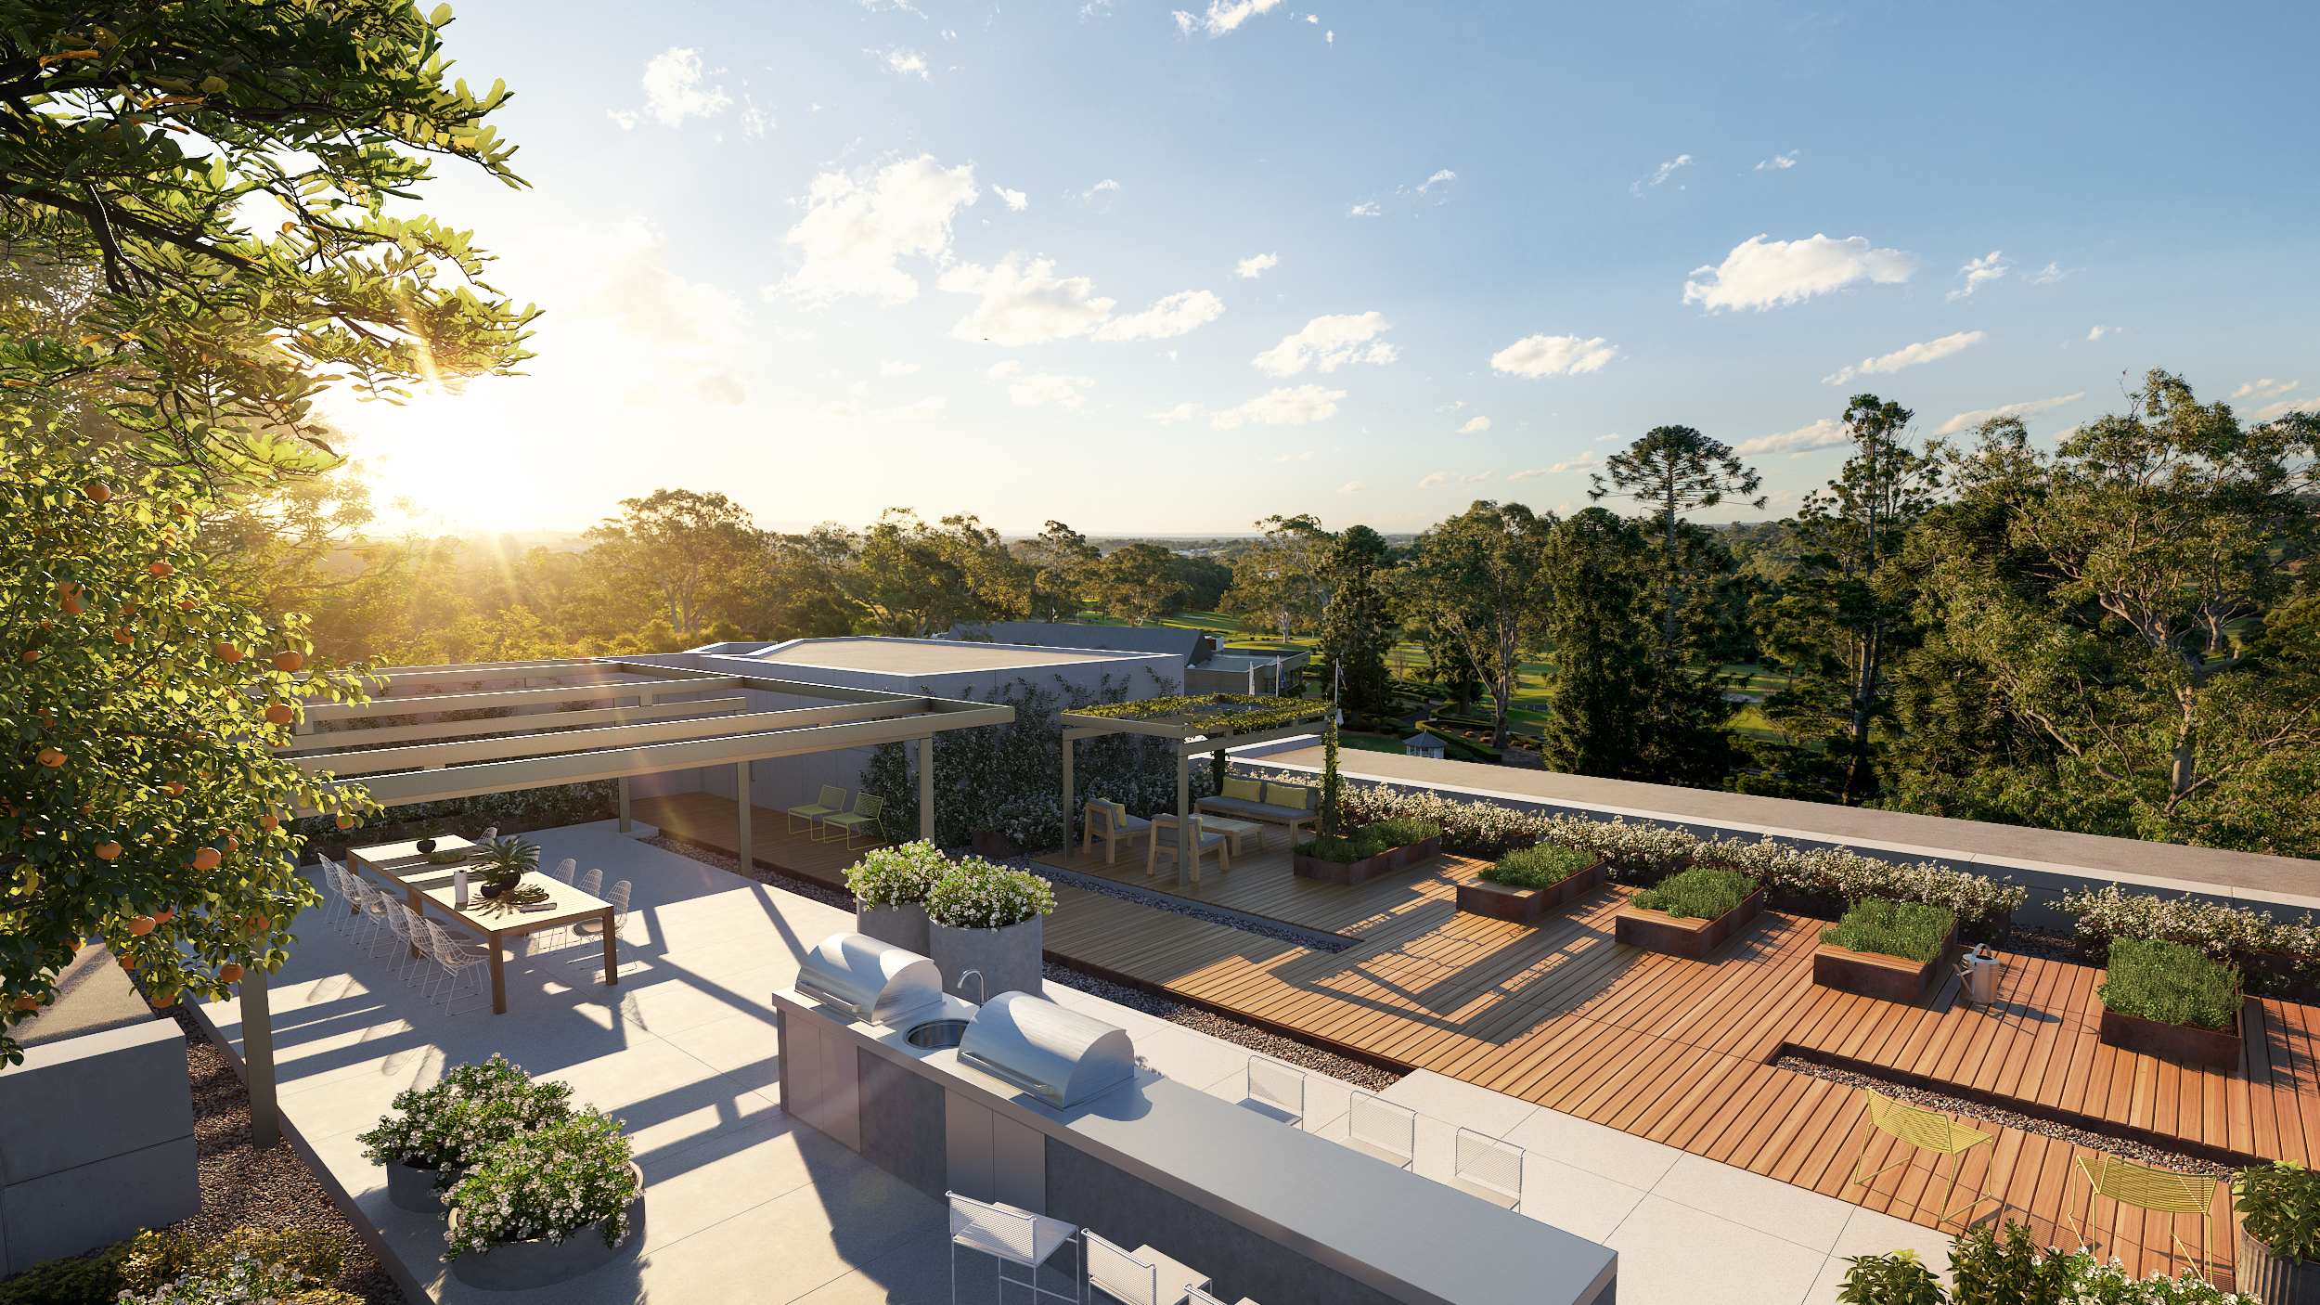
Why Choose Us
^{Image: Sekisui House}

Slide 12
Why Choose Us
^{Technical Experts}
When you work with us, you have access to some of the most experienced and forward-thinking sustainable building experts in Australia, relied upon by some of the biggest names in the national construction industry.
^{Policy Nerds}
We monitor new policies and documentation requirements so you don’t have to. Between us and our extensive industry network, we’ll ensure you meet, (if not, exceed!), ^{all of them.}
^{Integrated Team}
Our only goal (aside from producing high-performance buildings, of course!) is collaboration: understanding your project, how you operate and the type of solutions that will suit your budget and needs.

Slide 13
Why Choose Us
^{OUR PEOPLE ARE YOUR PEOPLE}
Our team hails from a range of professional backgrounds – from engineering and architecture to building design, environmental science and sustainable development – but we are bound by common passions: buildings and sustainability.
Combined with ongoing industry accreditation, our skillset means we have an enormous knowledge pool to draw upon when providing leading ESD and policy advice.
With 20+ years of experience behind us, we’re renowned as the industry’s proverbial ‘safe hands’. Our secret? It’s not just our expertise: it’s also the longevity of our team.
The top consultants you meet today, will often still be the people working with you project after project, year after year, which means we become more than consultants – we become a part of your team.
Efficient Living’s team offers an unrivalled spectrum of knowledge, melding intricate construction know-how with cutting-edge sustainability expertise.

Slide 14
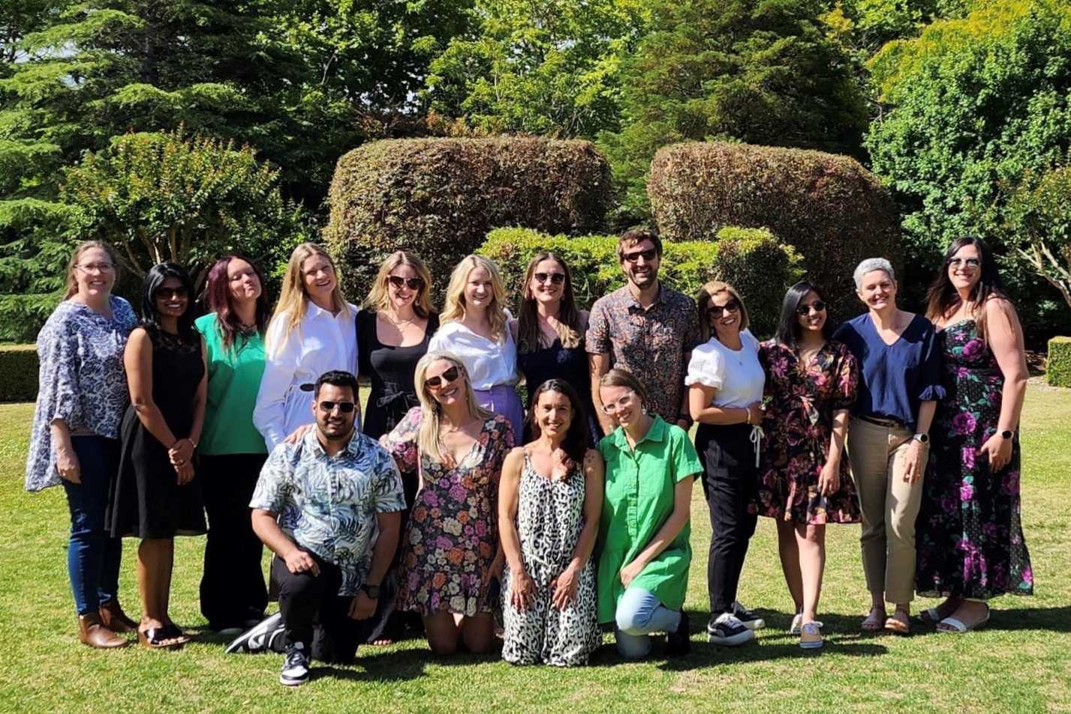
“On every occasion, [Efficient Living] has ​
exceeded my expectations in regards to timeliness and efficiency and all at a reasonable cost.”​
— Emile Jansen, Jansen Architecture

Slide 15
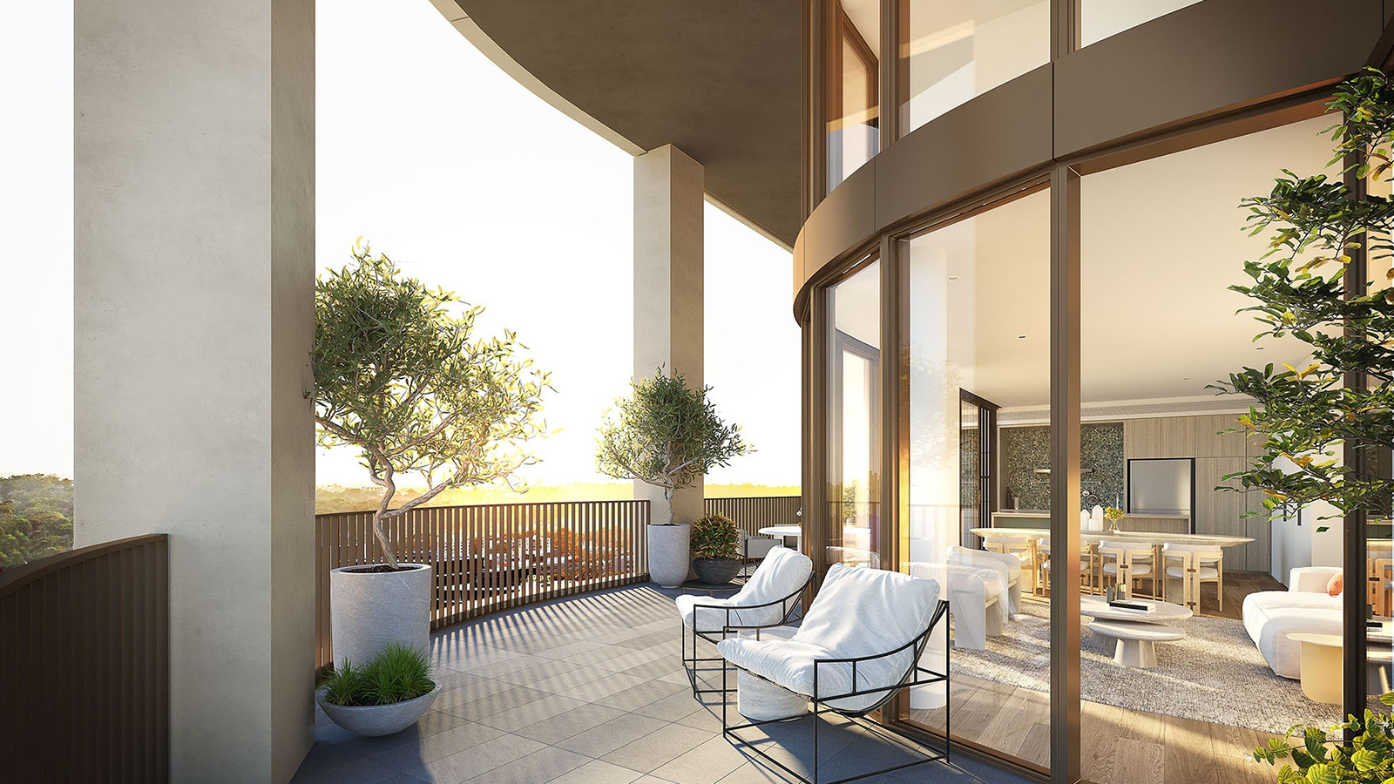
Our People
^{Image: Frasers Property}

Slide 16
Our Projects
^{Tracey Cools}
^{Managing Director}
Tracey is the visionary behind the 22-year-old journey of Efficient Living. As someone who has observed first-hand the changing landscape of Australian sustainability scene, she is a highly sought after ESD professional who has a depth of knowledge in all things sustainable.
Book in a consultation with her if you are interested in:
^{Policy consultation}
^{Industry education}
^{Construction compliance}
^{7-Star business readiness}

Slide 17
Troy Daly​
Senior Consultant​
Troy is a project leader running the balancing act between sustainability goals, commercial feasibility and delivery pragmatism. He has developed this skill after more than 15 years working on challenging medium- to large-scale developments across Australia, where sustainability goals are crucial to the project’s success and, frequently, the commercial and delivery solutions require more innovation than the technical solution. ​
​
Book in a one-hour consultation session to understand more about:​
​
- 7-Star homes​
- Net-zero strategies​
- Climate change adaptation strategies​
- Strategic carbon management​
- Electrification​
- Urban renewal​
- Inputs during master-planning and town-planning

Slide 18
Our Projects
^{Haylea Edwards}
^{Head of Residential Consulting}
Haylea's passion lies in working collaboratively with clients. She takes a holistic, sensible approach to finding sustainable solutions that achieve a better build outcome. She delivers exceptional customer experiences, in-depth knowledge and practical solutions that respect the clients’ objectives and reflect positivity on them.
With over 9 years’ experience, she has an expert understanding of residential building physics and offers unparalleled solutions that are tailored to the client and the project.
Book in a consultation session with Haylea to know more about:
^{7 star home design workshops}
^{NCC 2022 residential impacts}
^{Residential compliance support}
Project reviews and optimisation suggestions

Slide 19
Our Projects
^{Image: Frasers Property}

Slide 20
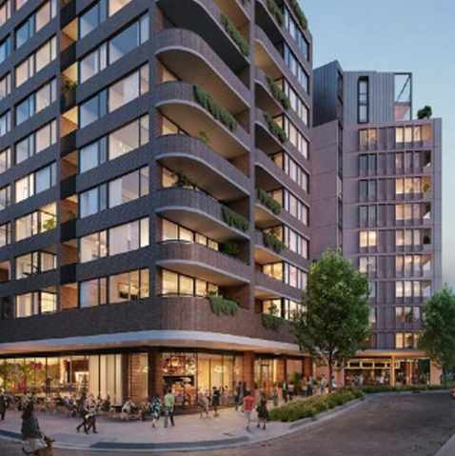
Our Projects
^{GREEN SQUARE}
^{Mirvac}
^{ESD Strategy & Implementation}
Efficient Living delivered regulatory assessments on both the residential and commercial elements of Green Square, assisting with ESD strategies from concept design, DA and CC documentation, through to on-site inspections and completion statements at each stage of construction. The project has received national recognition as one of Australia’s most sustainable communities.
^{1-11 OXFORD STREET}
^{Central Element}
^{NABERS & Green Star Consultant}
This project, revitalising an historic cinema into a 6-storey boutique hotel, is targeting a 5 Star Green Star as Built v1.3 rating, and 4.5 star NABERS Energy for Hotels and 4 star NABERS Water ratings. Efficient Living is guiding the process, incorporating roof-level photovoltaic panels, landscaped roof gardens, and water efficient/energy efficient systems and fittings, with a focus on lower operational costs.

Slide 21
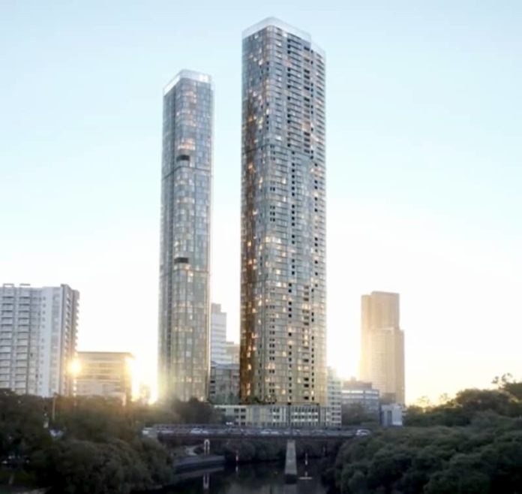
Our Projects
^{SHELL COVE}
^{Frasers}
^{ESD Consultant}
Frasers made a Carbon Neutral Commitment on its Shell Cove over-55s complex and engaged Efficient Living to help deliver the promise. Efficient Living optimized the thermal performance of the building envelope, improving window-to-wall ratios, installing high-performance glazing, insulation, ventilation, sealing the façade and adding orientation-based shading to largely eliminate heating and cooling demands. Shell Cove is also gas-free with EV charging facilities in all precincts.
^{180 GEORGE STREET}
^{Meriton}
ESD, NatHERS, BASIX and Section J – JV3
Focusing on quality, yet cost-effective solutions with minimal operational costs, Efficient Living ensured compliance for these 58- and 67-storey serviced apartment/residential towers, positioned over more than 2300sqm of retail and commercial spaces. Efficient Living collaborated with the client and glazing contractor to ensure suitable glazing, ample natural ventilation and solar control was installed throughout, while maintaining the building’s award-winning appearance.

Slide 22
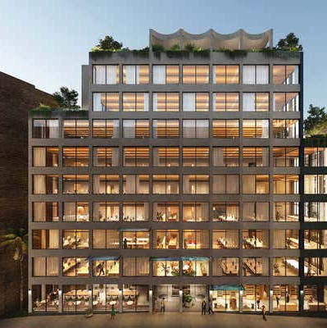
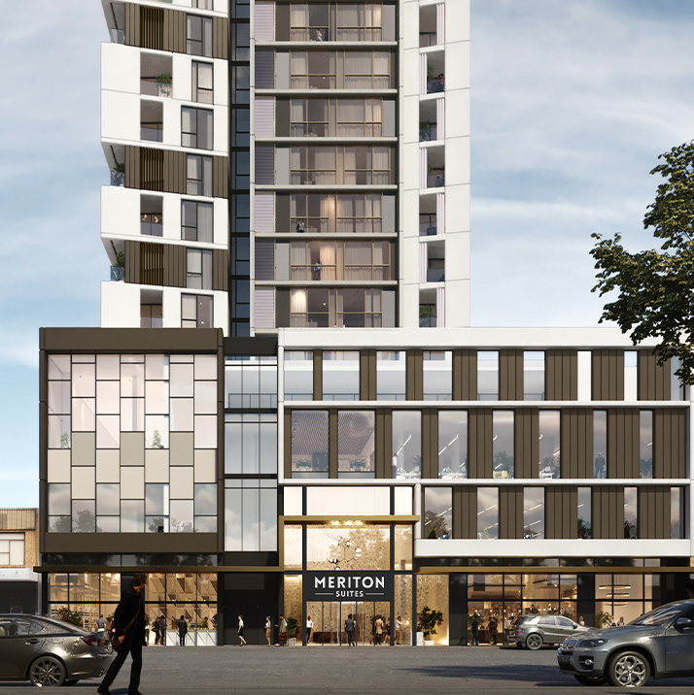
Our Projects
^{52–58 RESERVOIR STREET}
^{Cornerstone}
NABERS Consultant, Section J – JV3
Efficient Living prepared the NABERS Base Building 5.5 Star Energy Estimation Report and Section J JV3 for this mixed-use retail and commercial development, followed by close consultation with the client and contractors to ensure the rating was reached. The focus was on practical, buildable solutions with landscaped courtyards, terraces and rooftops, while the commercial tenancies enjoy column-free floorplates, expansive glazing, sunlight and natural ventilation.
^{167 NORTHUMBERLAND STREET}
^{Meriton}
ESD Report, Section J – JV3 & NABERS Consultant
Efficient Living prepared the ESD report, Section J JV3 and NABERS Energy services for this 31-storey mixed-use development, which comprises serviced apartments over a podium of ground floor retail, two storeys of commercial offices, childcare, gym and pool facilities. Targeting a 5-star NABERS Energy Rating, we worked alongside the Meriton design team to alter the original design for suitable glazing, insulation and shading to ensure compliance with Section J of NCC.

Slide 23
Our Projects
Our Clients

Slide 24
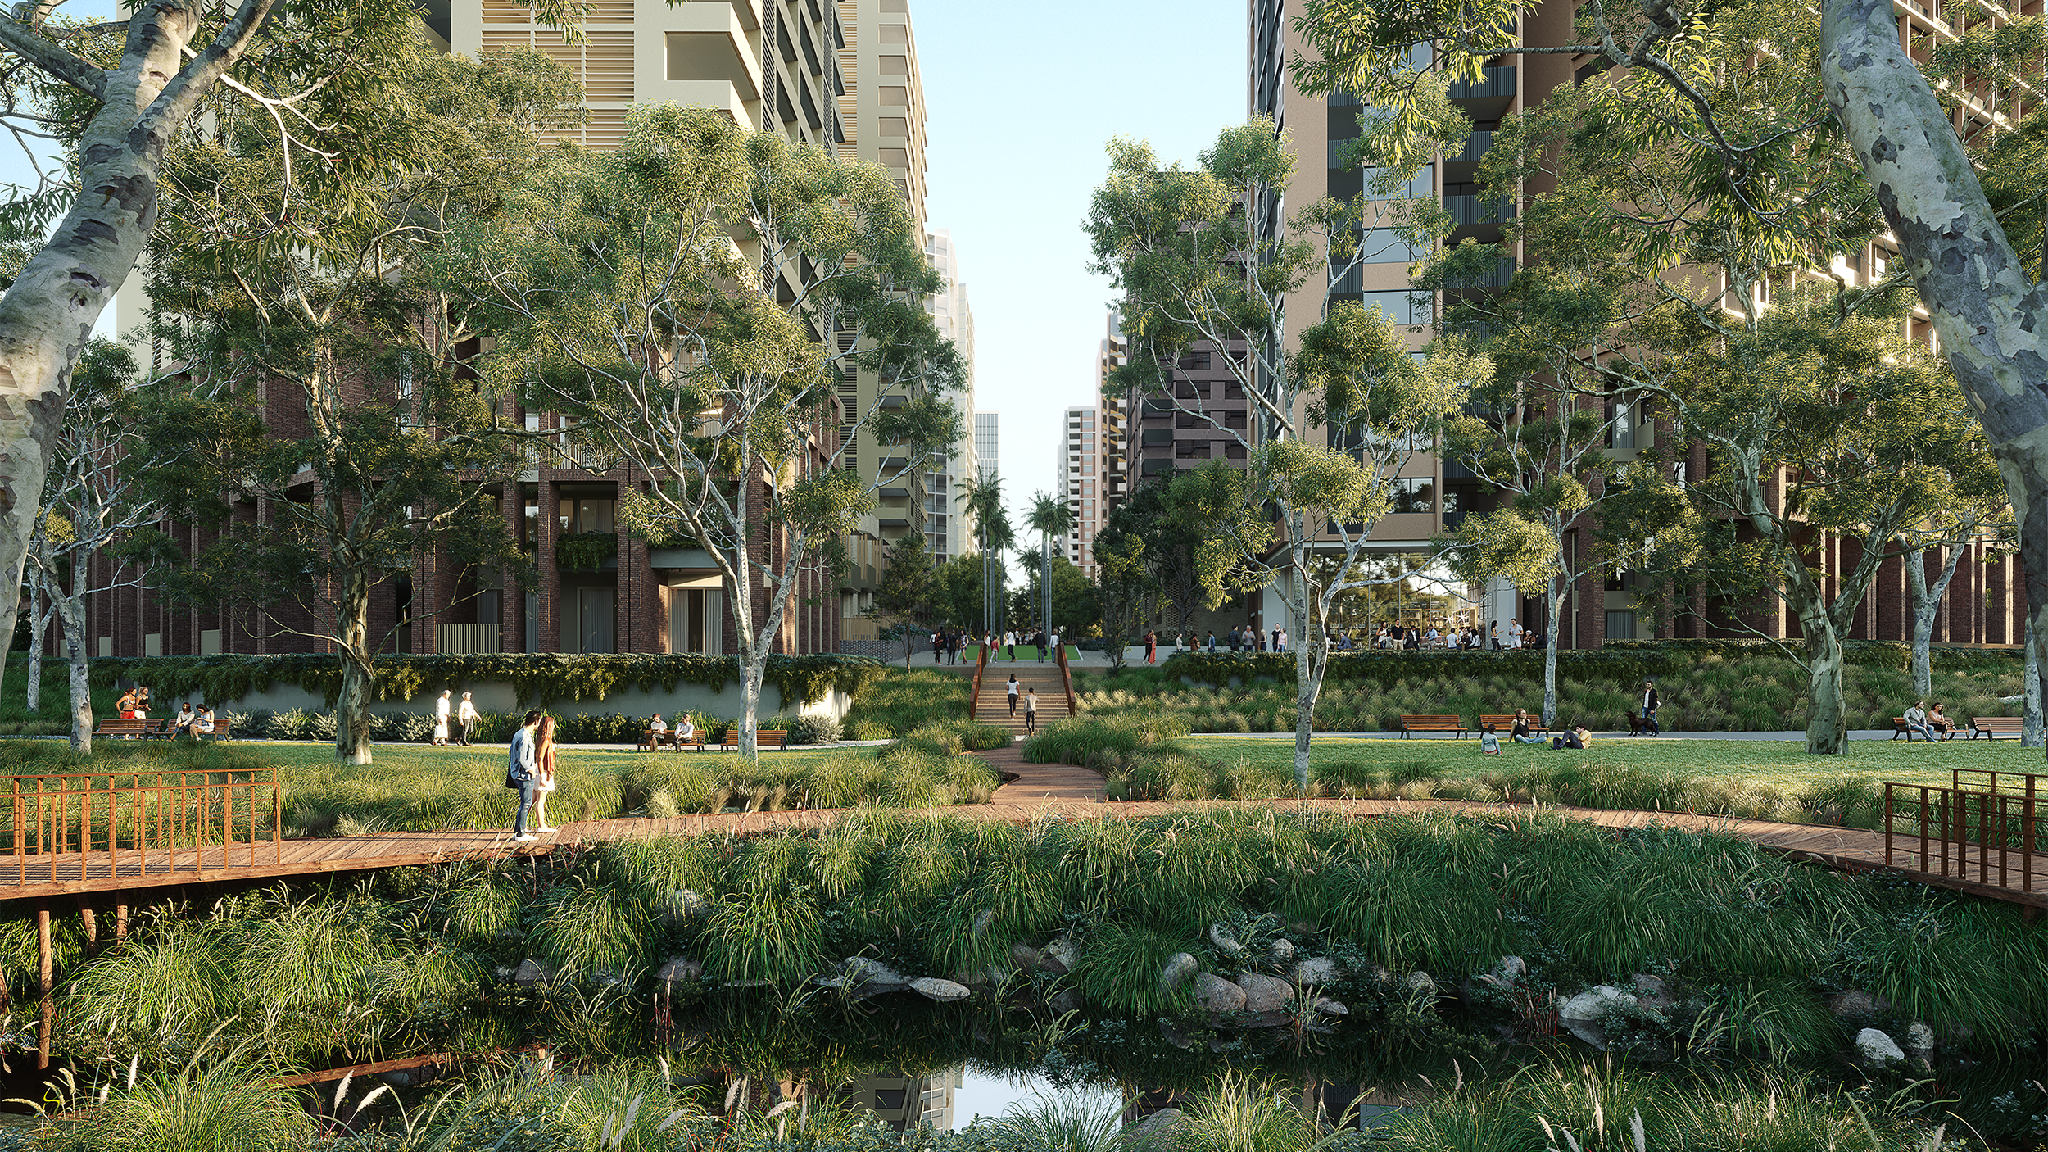
Contact Us
13/13 Lagoon Street, Narrabeen NSW (Sydney) ⁰² ⁹⁹⁷⁰ ⁶¹⁸¹ ^{admin@efficientliving.com.au} ^{efficientliving.com.au}
^{Image: Frasers Property}

